Slide 1
An Analysis of Medical Insurance Costs
Jack Miller and William Frauen

Slide 2
Introduction
The rise in healthcare costs that Americans have faced over the past few decades is a source of frequent debate and concerns regarding healthcare policy
Insurance expenses comprise a meaningful portion of many people’s budgets, so it is useful for individuals to learn how their characteristics are likely to impact medical insurance costs
We would like to understand what factors influence how much an individual pays for medical coverage, to what degree those factors impact insurance bills, and how these factors might interact with each other
Our aim is to explore how medical insurance charges relate to the characteristics of an individual such as age, gender, smoking status, among others.
We will seek to create a model for predictive purposes, as well as draw inference from the resulting fit
What types of people in the United States may be more heavily burdened with medical costs? What habits are influential on a person’s cost of medical care, and does that impact vary with other factors? What strategies should policy makers employ in order to help reduce the burden of medical coverage for their communities?
Notes:
In the United States, the significant rise over the past few decades in healthcare costs that Americans collectively pay each year has opened up frequent debate regarding healthcare policy. Additionally, with this rise in costs, insurance expenses comprise a significant portion of many American budgets, and individuals may be concerned about how much they are likely to end up paying for medical insurance given their characteristics. As a result, it is be helpful to understand what factors influence how much an individual pays for medical coverage, to what degree those factors impact insurance bills, and how these factors might interact with each other.
Our aim will be to explore how medical insurance charges relate to the characteristics of an individual such as age, gender, smoking status, among others. We will seek to create a model for predictive purposes, as well as draw inference from the resulting fit. We will try to answer questions such as: What types of people in the United States may be more heavily burdened with medical costs? What habits are influential on a person’s cost of medical care, and does that impact vary with other factors? What strategies should policy makers employ in order to help reduce the burden of medical coverage for their communities?

Slide 3
Data Set
Our data set is sourced from Kaggle, originally from Machine Learning with R by Brett Lantz
Link to data: https://www.kaggle.com/datasets/mirichoi0218/insurance
1,338 observations of 7 variables (1 response, 6 explanatory variables)
Charges: annual medical insurance cost billed to patient, in USD
Response variable
Age: age of patient, in years
Sex: sex of patient (male or female)
BMI: measure of body mass index of patient
Children: number of children of patient
Smoker: whether the patient is a smoker (yes or no)
Region: region of the United States that the patient is from (Northeast, Northwest, Southeast, Southwest)

Slide 4
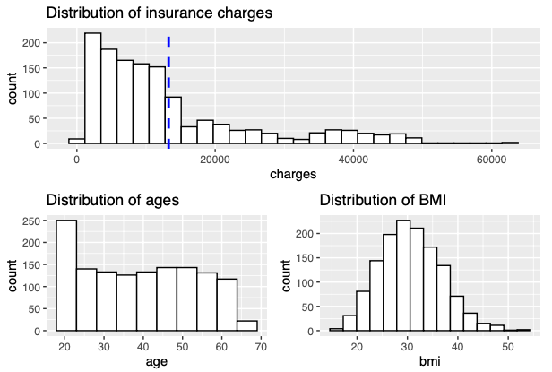
Exploratory Data Analysis (I)
Notes:
We first take a look at the distribution of the 1,338 insurance charges we have in our data set that serve as our response, as well as the distribution of ages and BMI, two potentially important predictors. Charges range from a low of $1,122 to a high of $63,770, have a mean of $13,270, a median of $9,382, standard deviation of $12,110, and we can see significant positive skew in its histogram. The ages in our data set range from 18 to 64, centered at a mean and median of 39, and we notice a relatively larger amount of the youngest individuals and a smaller amount of the oldest individuals. In between, the distribution is more or less flat for intermediate age ranges. The BMI values in our data set appear roughly normally distributed, with a mean of 30.7 and standard deviation of 6.1.

Slide 5
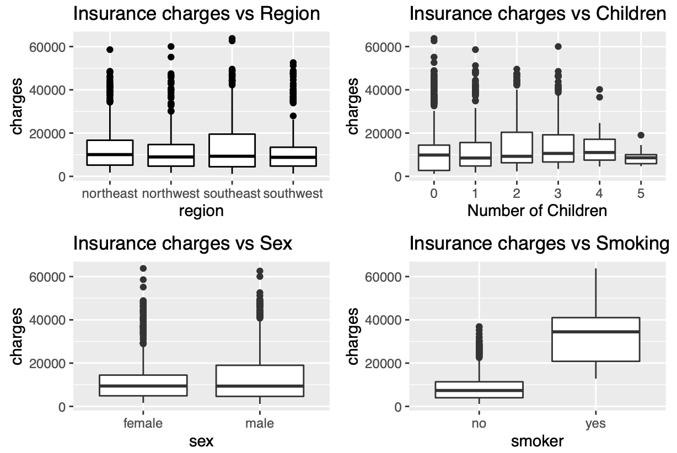
Exploratory Data Analysis (II)
Notes:
We now wish to take a look at how the insurance charges are distributed across a number of our predictor variables. We first note that insurance charges appear to have similar distributions across all four United States regions Northeast, Northwest, Southeast, and Southwest. Each group is centered at roughly the same charge, each with a fair number of high outliers among them. Plotting insurance charges vs number of children, we notice a very slight increase in the median charge generally as we increase the number of children. Plotting insurance charges vs sex, we observe very similar distributions between males and females. And in the last plot we can see that individuals who smoke appear to have significantly higher insurance bills compared to non-smokers. Taking this all together, we expect region and sex to not be very significant predictors for an individual’s annual insurance bill. Number of children may have a moderate effect, and we expect smoking to be a significant factor

Slide 6
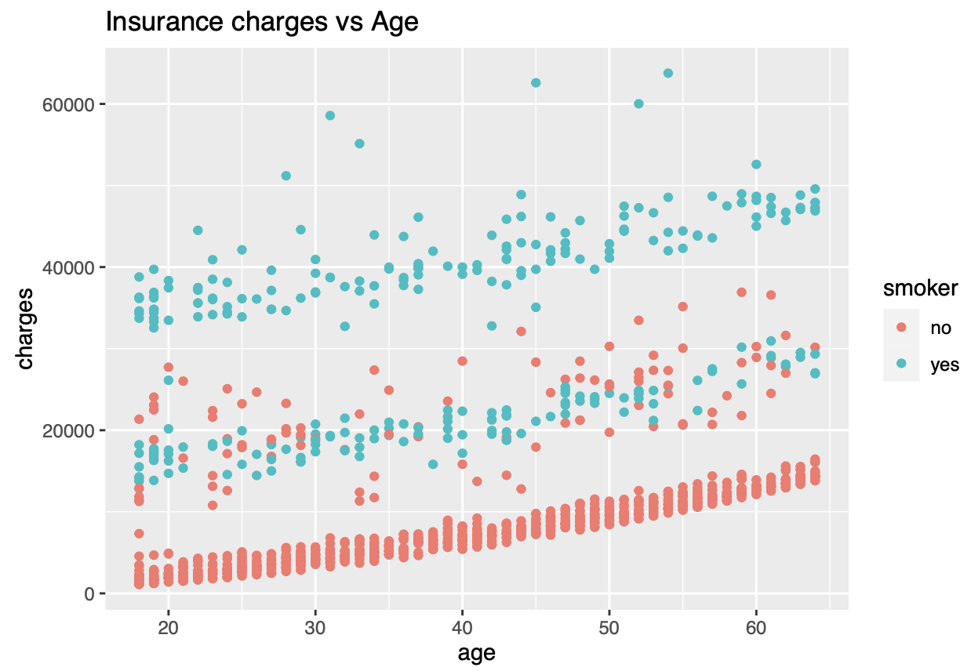
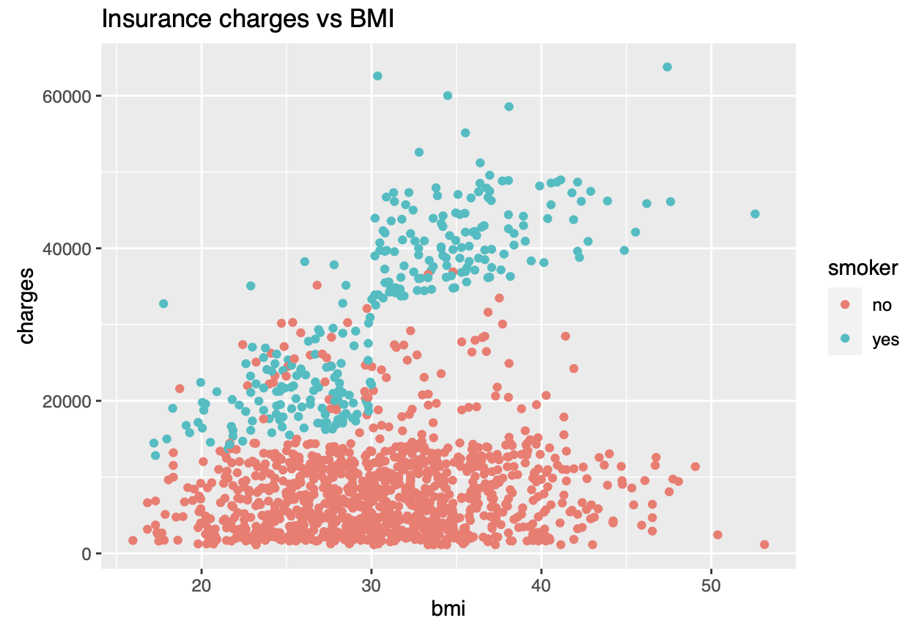
Exploratory Data Analysis (III)
Notes:
Plotting insurance charges across ages and coloring the points by smoking status, we can see that there appears to be a linear trend between charges and ages, for which, although the effect of age on charges does not appear to be significantly affected by smoking status, we can still see that smokers have a somewhat constant increase in charges vs non-smokers when laid out this way.
Plotting insurance charges across individual’s BMI’s and coloring the points by smoking status, we can see that there roughly appears to be a weak linear trend between insurance charges and BMI, but only when accounting for an individual’s smoking status. We notice that, especially for smokers compared to non- smokers, we see higher charges as we increase BMI. Indeed, however, we can see that the distribution of blue and red dots are far from perfectly linear, but we deem this approximation an appropriate trade-off between model prediction power and interpretability. In terms of what this means for our modeling, we will introduce an interaction term between smoking status and BMI to account for this interaction effect between these two explanatory variables

Slide 7
Model Exploration
Split data into training set of size 1,071 (~80%) and test set of size 267 (~20%)
OLS: All variables aplus interaction between BMI and smoking status to predict insurance charges fit to the training data. We then make predictions on the test data and compare it to the true test responses
Ridge + Lasso: Cross-validation used to find the optimal value of λ in our model fitted with all of the variables plus interaction between BMI and smoking status
Pruned Tree: We fully grow out the unpruned tree and then performed cross-validation to determine optimal tree size, which was the unpruned tree with 5 leaf nodes
Bagged Trees: Performed bagging with 500 trees
Random Forest: Created random forest with 500 trees and m = 2 candidate predictors at each split
Gradient Boosting: Performed gradient boosting with 1000 trees and an interaction depth of 2

Slide 8
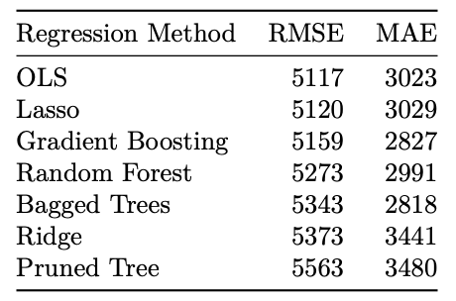
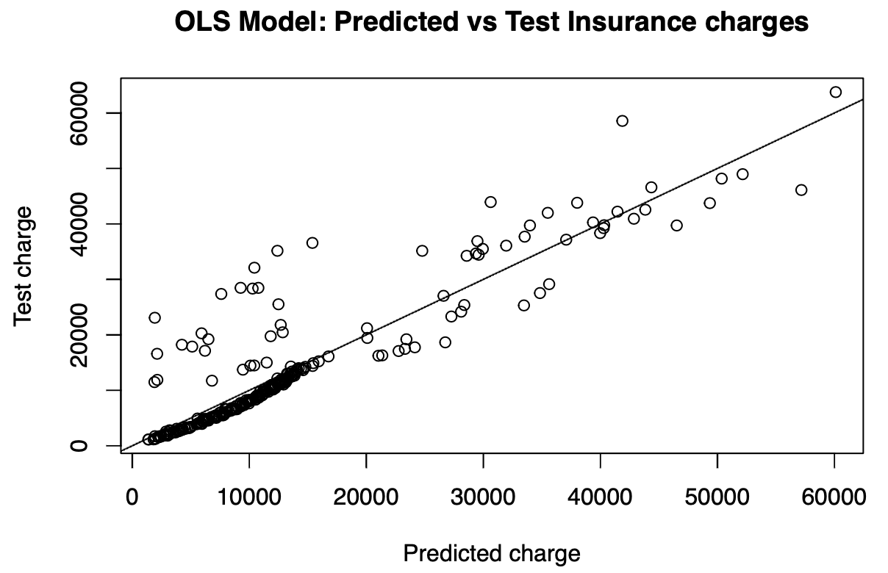
Model Selection

Slide 9
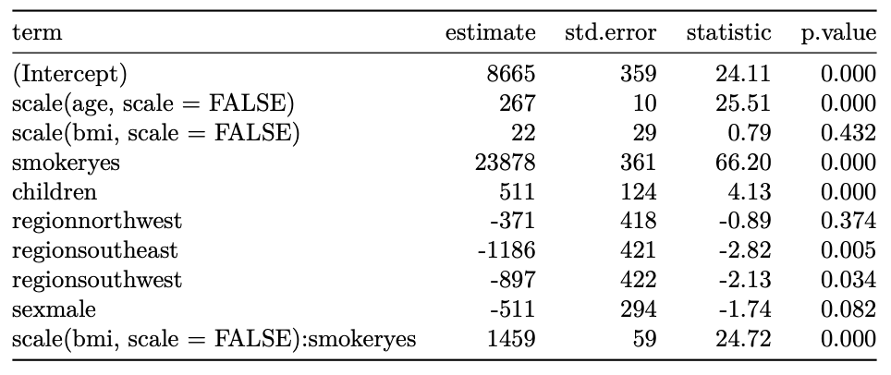
Findings (I) - OLS Coefficients

Slide 10
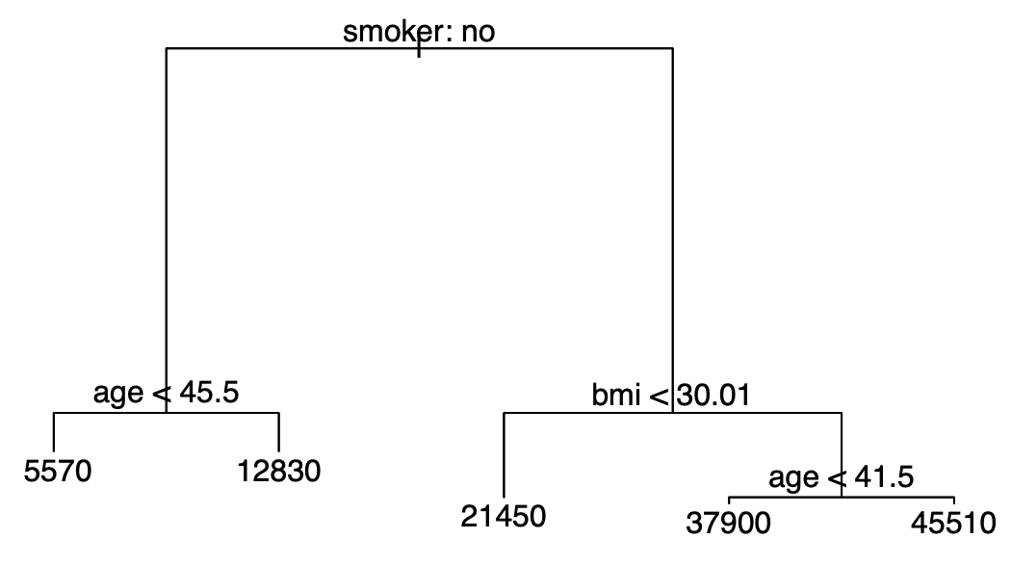
Findings (II) - Pruned Tree Diagram

Slide 11
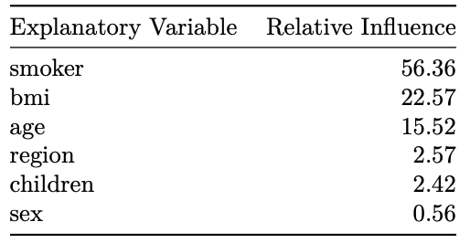
Findings (III) - Relative Influences from Boosting

Slide 12
Conclusions (I)
Most important factors in determining an individual’s annual medical insurance bill are smoking status, BMI, and age
Smokers expected to pay north of roughly $23,000 more versus non-smokers
Every one-unit increase in BMI for smokers corresponds to an almost $1,500 increase in charges ; effect of BMI insignificant for non-smokers
Increase in age corresponds to a roughly linear increase in charges, at a rate of around $267 per year.
Individuals most at risk of paying high medical insurance bills are those who are older, have larger BMIs, and smoke
Policy makers who want to alleviate healthcare costs that their communities face, should pursue policies that help reduce obesity, such as fitness and healthy eating campaigns, and smoking prevalence, such as informational campaigns about the dangers of smoking
Obesity and smoking prevalence, especially when tackled together, is likely to help to reduce the medical insurance charges individuals face on average
Notes:
Putting our findings together, we see that the most important factors in determining an individual’s annual medical insurance bill among those explored in this report are smoking status, BMI, and age. Our OLS model that we chose tells us that smoking has a large and significant impact on medical insurance charges. Indeed, smokers are expected to be paying roughly north of $23,000 more versus non-smokers, all else held constant. For smokers concerned about higher insurance bills, they should pay extra attention to their BMI, as every one-unit increase in BMI for them corresponds to an almost $1,500 increase in charges. Meanwhile, non-smokers need not worry about a higher BMI translating to higher medical insurance charges. Among all individuals, on the other hand, an increase in age corresponds to a approximately linear increase in insurance charges, at a rate of roughly $267 per year, all else held constant. Thus, the individuals most at risk of paying high medical insurance bills are those who are older, have larger BMIs, and smoke. An older, more overweight individual who smokes who wants to minimize their insurance charge should thus focus on trying to reduce their BMI and quit smoking if possible. For policy makers who want to alleviate medical costs that the public faces, while people’s age can’t be decreased by policy of course, they should pursue policies that help reduce obesity, such as fitness and healthy eating campaigns, and smoking prevalence, such as smoking informational/awareness campaigns. These factors of obesity and smoking prevalence, especially when tackled together, is likely to help to reduce the overall medical insurance charges individuals face on average.

Slide 13
Conclusions (II)
Number of children had a fairly limited impact on an individual’s expected charge, and the factors of geographic US region and sex had hardly any significant impact on insurance bills
Neither sex should be worried about receiving any meaningfully increase in their expected bill as a result of their gender
Those living in Northern regions of the US (NE + NW) are expected to be paying roughly $1,000 more than those in Southern regions (SE + SW)
Impact is small at best, so individuals need not worry about facing higher costs based on where they want to live in the US
Limitation: region variable is not very detailed – does not give particular state identities, rural/urban info, or political left/right leanings
Notes:
Meanwhile, the number of children had a fairly limited impact on an individual’s expected charge, and the factors of geographic US region and sex were found to have had hardly any significant impact on insurance bills. First, we note that it appears neither sex should be worried about receiving any meaningfully increase in their expected bill as a result of their gender. We also observe that individuals living in Northern regions of the US (NE + NW) are expected to be paying roughly $1,000 more than those in Southern regions (SE + SW), with the differences among North and South regions not being significantly different. Nevertheless, it appears this impact on insurance charges is at best small, less than our RMSE for OLS; so individuals moving around the United States need not worry about facing higher medical costs based on where they plan to live. However, one limitation to these findings is that these region variables do not have very high resolution, in the sense that we do not have more detailed and potentially helpful information such as the specific state the individual is living in, or whether it is a rural or urban environment, or whether the community is more left or right leaning politically. When broken down by these factors, it is possible that the geographic location of an individual might become an important factor in determining medical charges; though here we can only say that at the scope of these 4 US regions, geographic location does not appear to be a significant determinant of medical insurance bills.

Slide 14
Thank you for listening!

